Slide 1
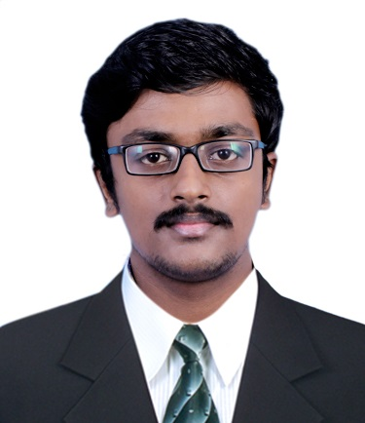



Arul Prasad R
Analyst/Software Engineer
Bachelor of Engineering
Computer Science : 2017 - 2021
Skills Java Core
Spring Boot
Microservices
MongoDB
ReactJS
Database
SQL database –MySQL
No SQL database – MongoDB
Web Technologies
HTML5
CSS3
JavaScript
Bootstrap
Add-Ons
GitHub
Maven
Postman
Additional Details
Good Communication Skills
Punctual
Hard working
Mumbai
arul.prasad-r@capgemini.com
+91-9995479220
A4
Dedicated Software Engineer who is strong in design and integration with intuitive problem-solving skills.
Ready to learn new technologies and implement them to improve my knowledge.
Eager to work in a team of dedicated people and serve a key role in the enhancement and development of the project.
Good hands on experience in GIT, Mongo DB
Good knowledge on Java 8 and OOPs concepts.
Has working knowledge on ReactJS and Java Microservice Development using Spring framework on an intermediate level.
Case-study - Flight Booking System
Successfully developed a complete case study on flight booking system using spring boot microservices as middleware, Mongo dB NoSQL database as backend and React Js as frontend.
Coursera certificate
Completed coursera course on HTML, CSS, and JavaScript for Web Developers and earned a certificate from Johns Hopkins University.

